Slide 1
CMPE 493 Information Retrieval Term Project Final Presentation
Mansur YeşİLBursa
Abdullah Yıldız
Can Devecİ

Slide 2
Overview
Baseline System, Mansur Yeşilbursa
Improvements, Can Deveci
Evaluations,
Thoughts on Future Work, Abdullah Yıldız

Slide 3
Baseline System
Exact Match
On Training Set
Performance: 22% correct normalization on dev set
On Ontology
Improved performance by 11%
Performance: 33% correct normalization on dev set
Lemmatization
Improved performance by 4%
Performance: 37% correct normalization in dev set
Abbreviation Resolution
No improvement on performance
Performance: 37% correct normalization in dev set

Slide 4
Baseline System
Cosine Similarity
If exact match is not possible
Improves performance by 10%
Performance: 47% correct normalization on dev set

Slide 5
Baseline Results
Algorithms | Model Improvement | Total Performance
Exact Match (Train + Ontology) | - | 33%
Lemmatization | 4% | 37%
Cosine Similarity | 10% | 47%

Slide 6
Models
11 different models tried
Developed in an evolutionary way

Slide 7
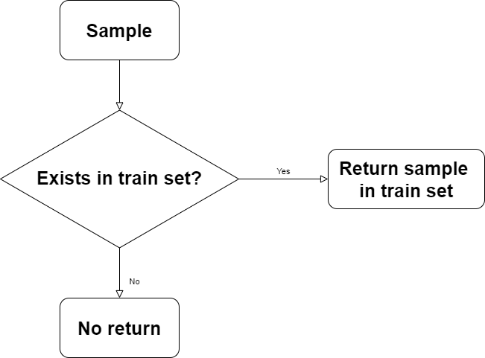
Model 1
MS | H | H (Exact) | H (NiD) | H (NiT) | H (OUFN)
0.1275 | 0.2451 | 0.2235 | 0.000 | NA | 0.1374

Slide 8
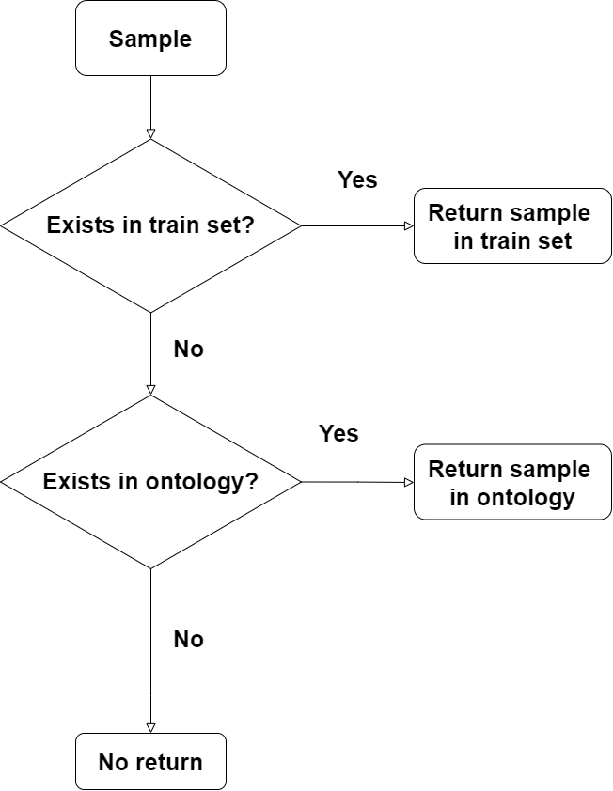
Model 2
MS | H | H (Exact) | H (NiD) | H (NiT) | H (OUFN)
0.1908 | 0.3669 | 0.3448 | 0.2597 | 0.000 | 0.2112

Slide 9
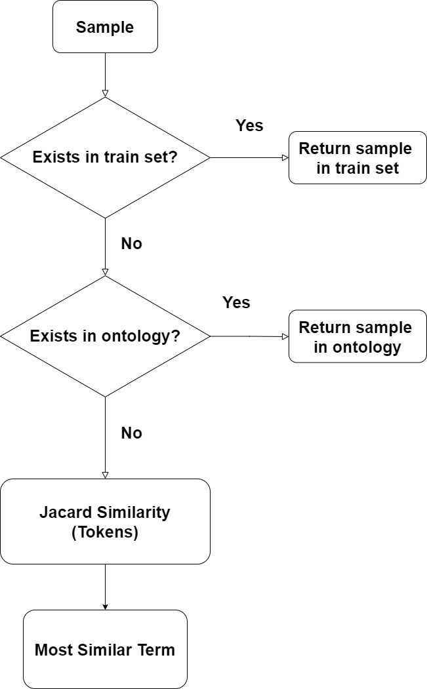
Model 3
MS | H | H (Exact) | H (NiD) | H (NiT) | H (OUFN)
0.3380 | 0.6500 | 0.5320 | 0.4469 | 0.000 | 0.5538

Slide 10
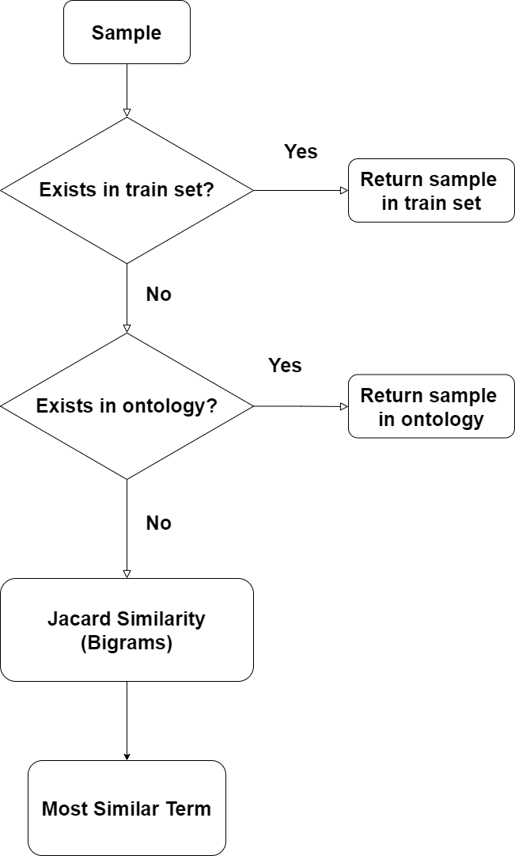
Model 4
MS | H | H (Exact) | H (NiD) | H (NiT) | H (OUFN)
0.3665 | 0.7047 | 0.5784 | 0.5154 | 0.000 | 0.6168

Slide 11
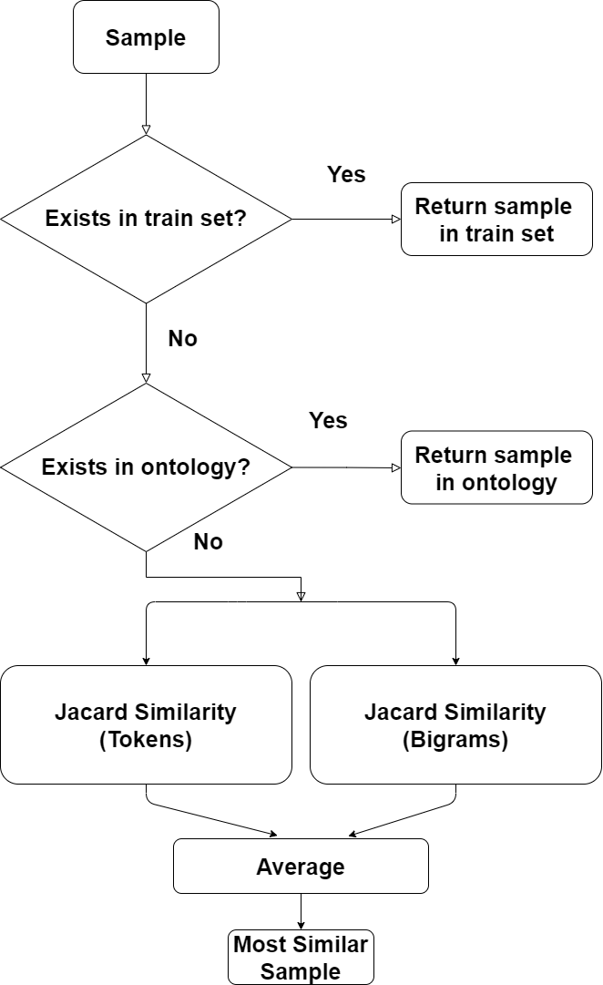
Model 5
MS | H | H (Exact) | H (NiD) | H (NiT) | H (OUFN)
0.3819 | 0.7344 | 0.6121 | 0.5169 | 0.000 | 0.6547

Slide 12
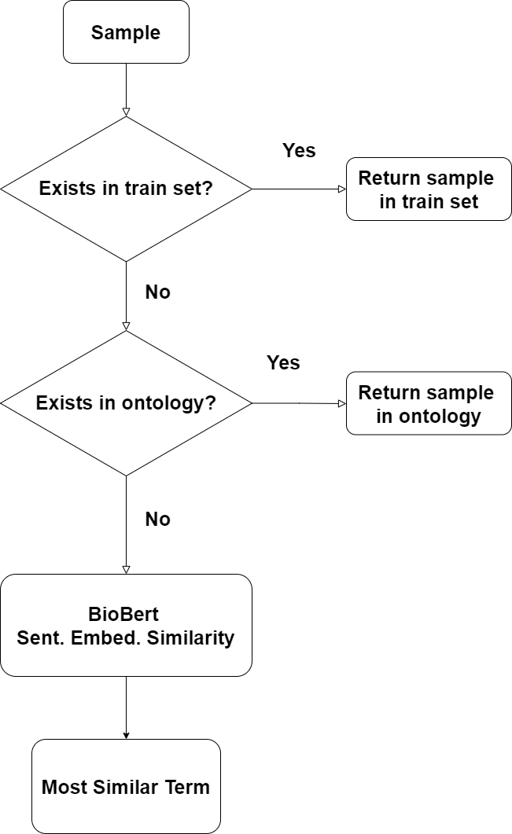
Model 6
MS | H | H (Exact) | H (NiD) | H (NiT) | H (OUFN)
0.3409 | 0.6555 | 0.4639 | 0.3135 | 0.000 | 0.5908

Slide 13
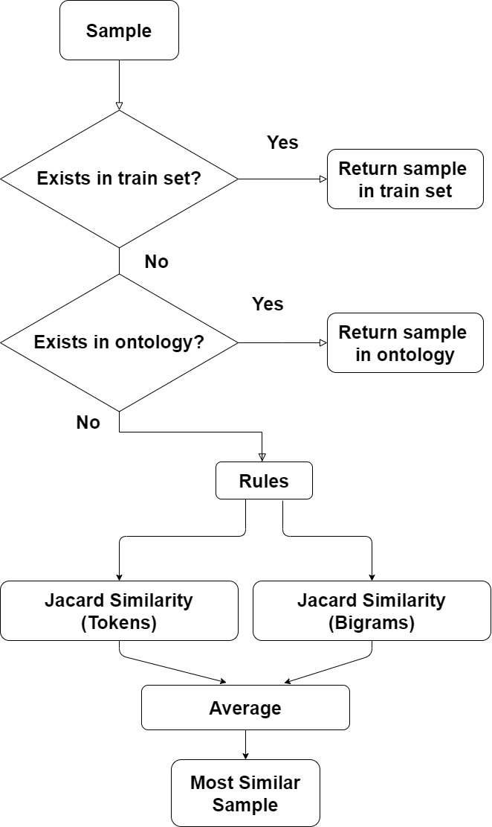
Model 7
MS | H | H (Exact) | H (NiD) | H (NiT) | H (OUFN)
0.4071 | 0.7829 | 0.6651 | 0.6202 | 0.000 | 0.7310

Slide 14
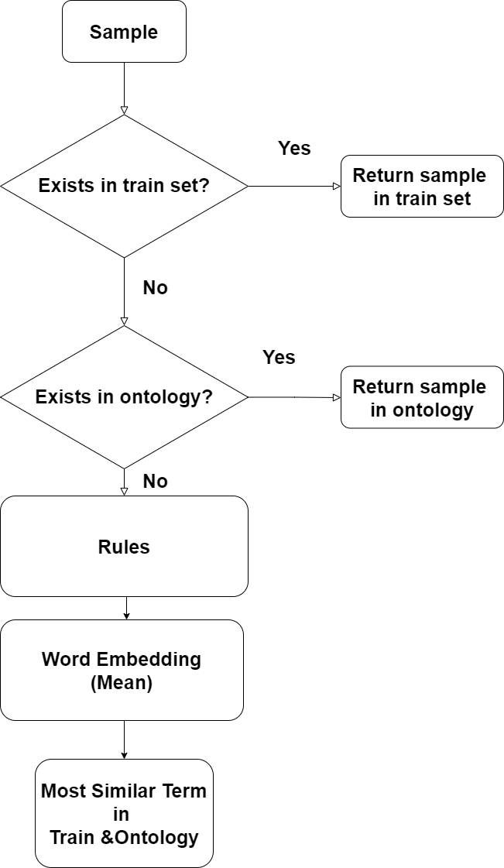
Model 8
 | MS | H | H (Exact) | H (NiD) | H (NiT) | H (OUFN)
Dev | 0.4281 | 0.8233 | 0.6951 | 0.6443 | 0.0000 | 0.7732
Test(*) | 0.3673 | 0.7219 | 0.5487 | 0.4906 | 0.09639 | 0.6962

Slide 15
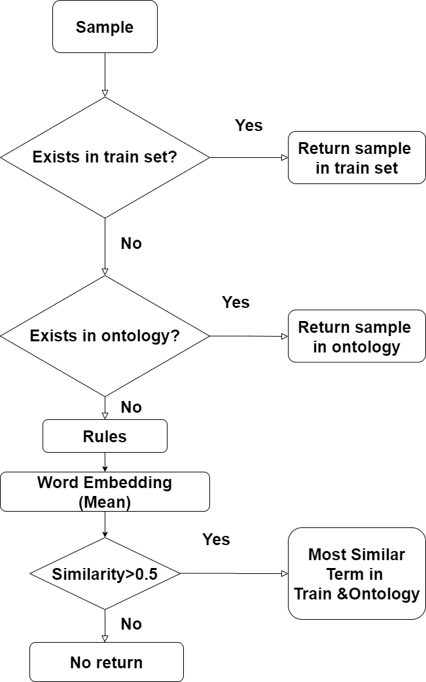
Model 9
MS | H | H (Exact) | H (NiD) | H (NiT) | H (OUFN)
0.4276 | 0.8222 | 0.6951 | 0.6443 | 0.000 | 0.7714

Slide 16
Overall Progress
Alg. | Set | MS | H | H (Exact) | H (NiD) | H (NiT) | H (OUFN)
EMT | Dev | 0.1275 | 0.2451 | 0.2235 | 0.000 | NA | 0.1374
EMTO | Dev | 0.1908 | 0.3669 | 0.3448 | 0.2597 | 0.000 | 0.2112
EMTO JT | Dev | 0.3380 | 0.6500 | 0.5320 | 0.4469 | 0.000 | 0.5538
EMTO JBi | Dev | 0.3665 | 0.7047 | 0.5784 | 0.5154 | 0.000 | 0.6168
EMTO JA | Dev | 0.3819 | 0.7344 | 0.6121 | 0.5169 | 0.000 | 0.6547
EMBB | Dev | 0.3409 | 0.6555 | 0.4639 | 0.3135 | 0.000 | 0.5908
EMTO JAR | Dev | 0.4071 | 0.7829 | 0.6651 | 0.6202 | 0.000 | 0.7310
EMTO RWE (*) | Dev | 0.4281 | 0.8233 | 0.6951 | 0.6443 | 0.0000 | 0.7732
EMTO RWET | Dev | 0.4276 | 0.8222 | 0.6951 | 0.6443 | 0.000 | 0.7714
EMTO RWE (*) | Test | 0.3673 | 0.7219 | 0.5487 | 0.4906 | 0.09639 | 0.6962
+2 models: TF-IDF & POS Tagging (Headword), didn’t improve results

Slide 17
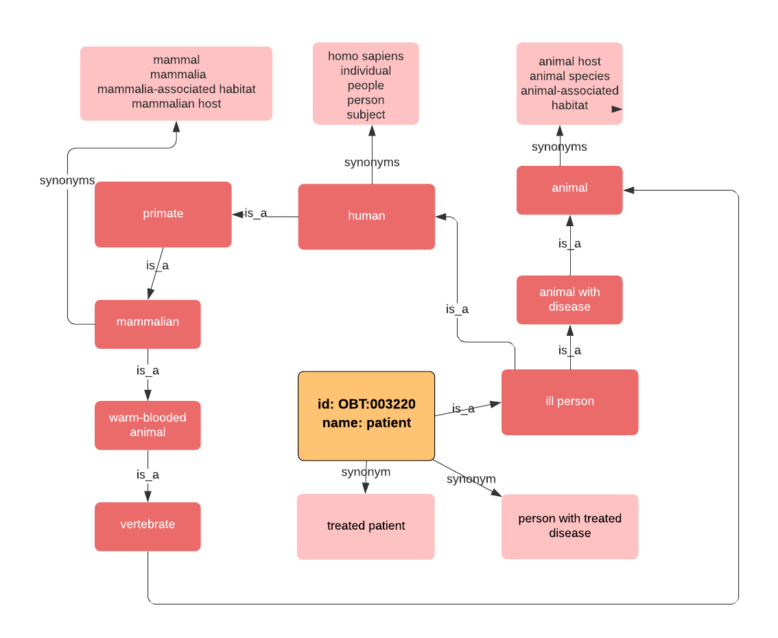
Future Work
[1] Graph based representation
of Ontology set
Using is_a / synonym relations
given in OntoBiotope dataset

Slide 18
Future Work
BioNLP word embeddings

Slide 19
Future Work
Part of Speech Tagger to extract valuable information
Noun phrases, noun clauses (NN)
e.g. TermName: sexually transmitted infection clinics. Found: patient with infectious disease. Actual: clinic
e.g. TermName: marine organisms. Found: marine environment. Actual: living organism
e.g. TermName: animal blood. Found: animal blood. Actual: blood

Slide 20
Future Work
Fasttext Based Word Embedding
Extention of word2vec modelling
Uses subword tokens as n-grams of characters
This helps capture the meaning of shorter words and allows the embeddings to understand suffixes and prefixes
e.g. TermName: gastroenteritis patients. Found: patient. Actual: patient with infectious disease
Gastroenteritis : known as infectious diarrhea
-itis : diseases characterized by inflammation

Slide 21
Thank you

